Slide 1

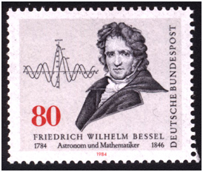
Finding g
Alexander Knight & Nicholas Anna
University of Southern Maine
Dept. of Physics

Slide 2
Outline
Purpose: The purpose is to find g.
How: We will cover theory (spoiler: everything is a pendulum) and experimental setup.
Data: Show rough pass data & fine tune data
Conclusions and Data Analysis

Slide 3
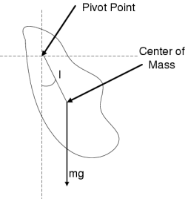

Kater Pendulum
*Image Source: https://cnx.org/resources/e599803aa6fd67a122da031edf726c8457f0e432/cp-scaled.png

Slide 4
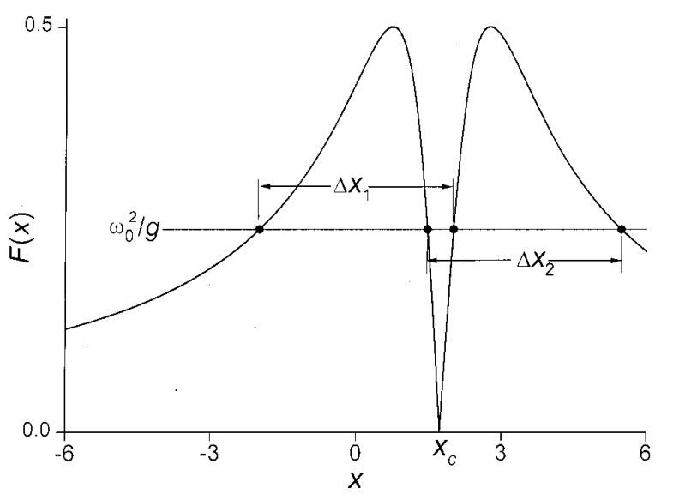

Kater Pendulum
*Image Source: Candela, D. et al. “Bessel's Improved Kater Pendulum.” December 2000.

Slide 5
Bessel's Corrections
Buoyancy: Because the pendulum displaces a volume of air, its inertial mass and observed gravitational mass is not the same. This changes the effective moment of inertia of the pendulum.
Dragged air: Because the pendulum drags some air along with the bob as it travels, this increases the apparent moment of inertia.
The Fix: If the pendulum is constructed so that it has that it has symmetrical profile, these corrections cancel out.

Slide 6
Experimental Setup

Slide 7
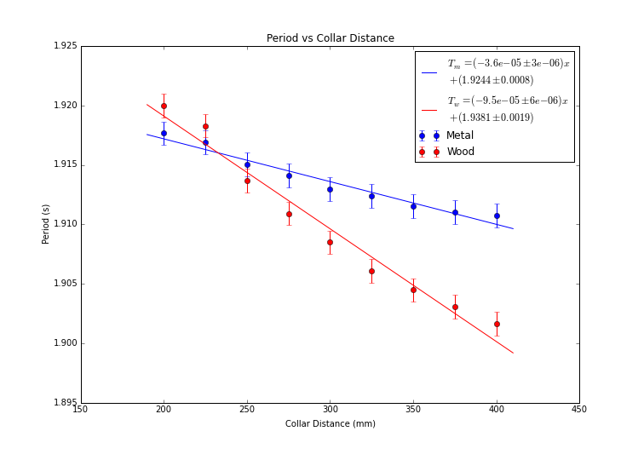
Rough Data
Intersection is at approximately 232.7 mm. We shall take finer readings around this area.

Slide 8
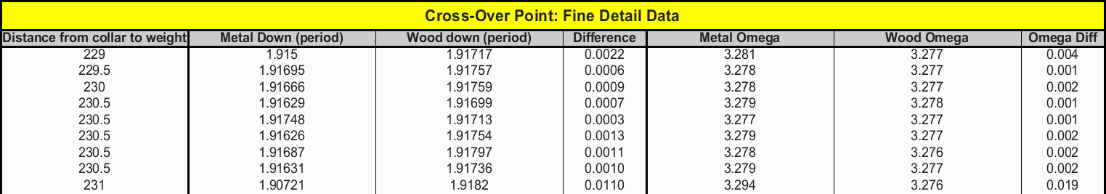

Fine Data & Uncertainties

Slide 9

Conclusions & Error
Error from NIST: 0.3% error

